Slide 1
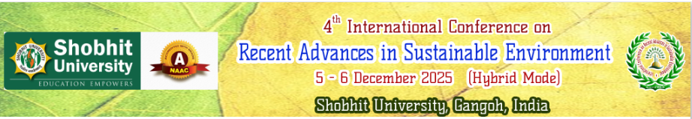


Weather Forecasting
Presented By:
Paper_ID
74
Fajlu Rahaman
Shobhit University Gangoh

Slide 2
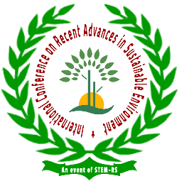


Understanding the Science Behind Predicting Weather
Introduction
Weather forecasting is the scientific process of predicting the future state of the atmosphere for a specific place and time. It helps us know whether it will rain, be sunny, cloudy, windy, or stormy in the coming hours or days.

Slide 3
History of Weather Forecasting
Ancient methods: observing clouds, wind, stars.
19th century: Telegraph and barometer-based predictions
Modern era: Satellite imagery and computer models

Slide 4
Elements of Weather
Temperature
Humidity
Precipitation (rain, snow, hail)
Wind speed and direction
Atmospheric pressure
Cloud cover

Slide 5
Tools Used in Weather Forecasting
Satellites: Monitor large-scale weather patterns
Radar: Tracks precipitation and storms
Weather balloons: Collect upper-atmosphere data
Weather stations: Measure ground-level conditions
Supercomputers: Process vast data using forecasting models

Slide 6
Methodology in Forecasting Weather
1. Data Collection
Weather stations, satellites, radars, buoys, aircraft reports
2. Data Assimilation
Integrating observations into computer models
Cleaning + adjusting data for accuracy
3. Numerical Weather Prediction (NWP)
Supercomputers run atmospheric equations
Models simulate future weather patterns
4. Model Interpretation
Meteorologists compare multiple models
Identify trends, uncertainties, and anomalies

Slide 7
Types of Weather Forecasts
Now casting: Next few hours
Short-range: 1–3 days
Medium-range: 4–7 days
Long-range: Weeks to months ahead
Seasonal forecasts: Climate trends and patterns

Slide 8
Methods of Weather Forecasting
Persistence Forecasting: Assumes current conditions continue
Climatology: Based on long-term average conditions
Analog Method: Comparing with past weather patterns
Numerical Weather Prediction (NWP): Using mathematical models

Slide 9
Role of Satellites and Radar
Real-time images of cloud movement and storms
Tracking hurricanes, cyclones, and fronts
Crucial for global forecasting and disaster warnings

Slide 10
Importance of Weather Forecasting
Public safety: Storm warnings save lives
Agriculture: Helps farmers plan crop cycles
Transportation: Aviation and shipping depend on accurate forecasts
Event planning & energy management

Slide 11
Challenges in Weather Forecasting
Sudden weather changes
Incomplete or inaccurate data
Limitations of computer models
Local factors affecting weather unpredictably

Slide 12
Future of Weather Forecasting
AI and Machine Learning in models
Improved satellite technology
High-resolution and hyperlocal forecasts
Climate change and the need for better prediction systems

Slide 13
Conclusion
Weather forecasting is a critical scientific process
Combines observation, data analysis, and technology
Essential for safety, planning, and sustainable living.

Slide 14
Bibliography
1. Bi, K., Xie, L., Zhang, H. et al. “Accurate medium-range global weather forecasting with a 3D neural network.” Nature, 619, 533–538, 2023.
2. Lam, R., Mordatch, E., & Weber, I. “Learning skillful medium-range global weather forecasting.” Science, 382(6677), eadi2336, 2023.
3. Price, P., Rasp, M., Sanchez-Gonzalez, D. et al. “Probabilistic weather forecasting with machine learning.” Nature, 637, 84–90, 2025.
4. Kochkov, D., Yuval, J., Langmore, I. et al. “Neural general circulation models for weather and climate.” Nature, 632, 1060–1066, 2024.
5. Hersbach, M., Bell, E., Berrisford, P. et al. “The ERA5 global reanalysis.” Quarterly Journal of the Royal Meteorological Society, 146, 1999–2049, 2020.
(Data source used in testing)

Slide 15
Thank You!
Email_ID - fajlurahaman185@gmail.com

